Slide 1
Training on prevention of sexual exploitation and abuse

Slide 2
Your
trainers:
Picture of Trainer 2
Picture of Trainer 1
Name of trainer 1
(Pronouns)
Short description to go here. Short description to go here.
Name of trainer 2
(Pronouns)
Short description to go here. Short description to go here.
Notes:
Trainers introduce themselves.
Name and pronouns (if participants are not used to sharing their pronouns, explain why this is important)
Your organization (for mutli-organizations trainings)
Your role
Who organized this training and why
Adapt this slide
Add pictures, name, pronouns and short bio of each trainer on the slide.

Slide 3
Training programme:
 | Day 1 | Day 2
Morning | Hello and welcome What is SEA? | Reporting SEA Conclusion
Afternoon | The Six Core Principles and the Code of Conduct Identifying SEA
Notes:
Trainers present :
the programme
time and session duration
number of breaks

Slide 4
Training programme:
Notes:
Trainers introduce the training:
This training was created by Digna, the Canadian Centre of expertise on the Prevention of Sexual Exploitation and Abuse (PSEA), funded by Global Affairs Canada.
Digna’s goal is to help Canadian international development and humanitarian organizations improve their ability to PSEA, including towards their program participants -particularly women and girls. They aim to increase awareness of, access to, and use of gender-responsive policies and good practices to PSEA.
This training builds on a PSEA train-the-trainer Digna organized in the summer 2022.
The training builds on three main sources:
Digna’s numerous publications on PSEA, especially their guide on case study scenarios for PSEA trainings.
Interaction’s PSEA training materials (2022 version)
IASC’s Saying no to sexual misconduct training

Slide 5
Code of Conduct:
Notes:
Trainers introduce the Code of Conduct
We are using Digna’s Code of Conduct in this training. Digna requires all participants of their events to follow their Code of Conduct. We ask you to respect these principles throughout the training.
All participants commit to:
RESPECT: being respectful, candid, transparent, and fair to all participants regardless of language, race, national or ethnic origin, age, sex, gender, sexual orientation, marital status, ability, etc. throughout the training.
INCLUSION: creating space for all in attendance to contribute and participate, to give prominence to the voices and stories of those who might otherwise be excluded, and to seek out the wisdom and reflection of those who may feel silenced.
EQUITY: encouraging a forum in which the varied experiences of participants are given equal weight.
HUMILITY: participating in the forum with a spirit of openness to learning, and a recognition that the broad diversity of participants includes experience and knowledge that is beyond my own, and through which I can grow.
SAFETY: ensuring the physical, emotional, sexual, and spiritual safety of all participants in the conference, including by calling out harassment when it is witnessed and reporting incidents to conference organizers or other authorities as appropriate.
SOLIDARITY: the broad goals of strengthening Canada's global leadership and recognize that all participants share those goals. In all conversations and forums, I will remember that we are on the same side and will seek to find common ground and inspiration.

Slide 6
Trigger warning:
Psychosocial support available
Notes:
Trainers give a trigger warning to participants:
Sexual abuse and exploitation is a sensitive topic. It may trigger difficult emotions or remind you of things you have experienced or seen. Do not hesitate to take a break if you need or come and find us.
Adapt this slide
If you are offering psychosocial support to participants, introduce the system and how they can use it.
Distribute a list of emergency contact participants can reach out to for support.

Slide 7
Safer space guidelines:
Active listening
Care & self-care
Respect
Integrity
Confidentiality
No disclosing
Notes:
Trainers introduce the safer spaces guidelines:
Principles of engagement are necessary in any training in order to create a learning environment that is as comfortable as possible for everyone. Although no space can be entirely safe, there are things we can all do to make it safer:
care and self-care
active listening
respect
integrity
confidentiality
no disclosing
Trainers ask participants if they would like to add anything to the list.

Slide 8
Ice-breaker:
Who are you?
Name / Pronouns / Organization / Position
Notes:
Adapt this slide
If participants are from the same organization and know themselves, facilitate an energizer instead of an ice-breaker.

Slide 9
What is sexual exploitation and abuse?

Slide 10
SEA: the current situation
February 2016
September 2019
October 2018
May 2018
Notes:
No space is exempt from sexual violence.
News such as the ones on the slides have revealed to the world that humanitarian organizations are no exception. Organizations that are meant to protect vulnerable individuals have caused harm.

Slide 11
Respect
and power
Notes:
The lack of respect and the improper use of power are fundamentally linked to why sexual exploitation, abuse and harassment occur. We will now look into these two notions.

Slide 12
PSEA: it’s everyone’s responsibility
Notes:
Trainers play the video, then ask participants about their reactions.
We are now going to watch a video that discusses the responsibility of aid workers to uphold the highest standards of conduct and to protect people from SEA, one of the most harmful abuses of power.

Slide 13
PSEA: it’s everyone’s responsibility
Whole group discussion:
What are your thoughts about the video? What did you notice?
What were the main themes you noticed in the video?
Notes:
Trainers lead a group discussion about the video and document the responses on a flipchart (or a virtual white board)
Trainers may complete participants answers if needed:
Aid workers have power and could abuse that power
Respect
Responsibility
Consequences of SEA
Aid workers are perceived to have access to resources/aid
Sexual exploitation and abuse
Dignity
Reporting
Confidentiality

Slide 14
Actions that demonstrate respect
How do you expect to be treated with respect in the workplace by your colleagues? In small groups, create two lists:
1.
Actions that show respect
2.
Actions that do not show respect
Notes:
As we saw in the video, the most important rule that John and Fatima have in their work with their colleagues and community members is treating people with respect. We will now do an exercise to discuss on this notion.
You will work in small groups. Each group will create two lists: 1) Actions that show respect; and 2) Actions that do not show respect. Make sure to appoint a notetaker and a rapporteur.
After 10 minutes, bring participants in plenary and ask each group to share one item at a time from each column of Respectful and Disrespectful actions in the workplace that their group identified. Groups keep taking turns sharing something that hasn’t been already shared until they run out of new items.
Document responses on a flipchart paper labelled “Respectful Actions/Disrespectful Actions.
Remember that the concept and acts of respect may look very different in different contexts. For instance, in some cultures, one form of respect is not to disagree with or bring shame on someone older or more powerful than you. That can be a barrier to reporting abuse and may need to be discussed if it comes up. One option is to ensure it is recorded on “the Parking Lot” and be sure to revisit it when discussing different reporting channels and methods that would allow someone to safely and confidentially report on someone in a position of authority or power.
Examples of answers:
Respectful Actions:
Be treated with kindness
Maintain appropriate boundaries for my personal space
Being heard without judgment
Hearing positive words and encouragement
Be treated with empathy when facing difficulty
Encouraged to share viewpoints and input
Feeling like our opinion was heard and valued
Being appreciated and valued for contributions
Treating people fairly and equally
Disrespectful Actions:
Yelling or using harsh language
Touching others inappropriately or without consent
Making harassing or sexual comments about others
Joking about or making fun of others
Gossiping about others or teasing
Not following policies or procedures when other staff are following the rules
Taking credit for someone else’s work
Belittling or undermining someone else’s work
Being lied to or telling lies about others
Not sharing information with others that they need to make decisions

Slide 15
Actions that demonstrate respect
How do we treat program participants and community members with respect?
Notes:
Trainers facilitate a whole group discussion for 7 minutes.
Now that we have established how you want to be treated with respect in the workplace, let’s take a minute to think about how these same actions of respect and disrespect might apply to how we treat program participants and community members?
Is the list the same? Which ones are especially important? Is there anything missing?
Encourage the following additional points of DISRESPECTFUL ACTIONS toward program participants or community members:
Abusing one’s power for personal benefit and/or to hurt someone else
Taking advantage of others who are experiencing difficult circumstances

Slide 16
Actions that demonstrate respect
What actions of respect or disrespect in this list do you think are most important when we talk about the examples of sexual exploitation and abuse we saw in the video?
Notes:
Print the handout for this exercise and follow the instructions.

Slide 17
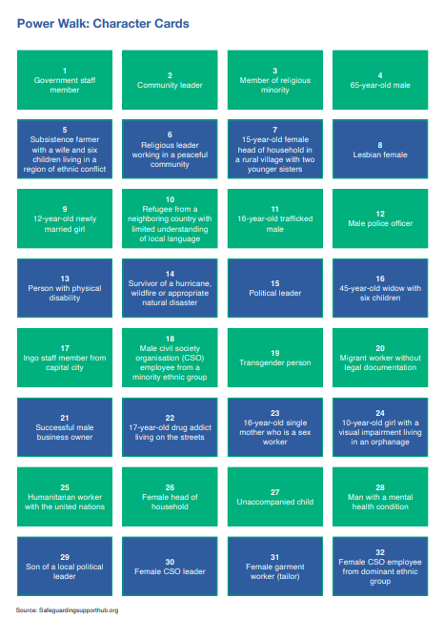
Identifying
Positions of Power
Notes:
Print the handout for this exercise and follow the instructions.

Slide 18
Key messages on power
Inequalities contribute to heightened risk of SEA
Focus on who holds power and ask if they are using it responsibly
Intersectional perspective
Notes:
The inequalities and barriers that may exist within development and humanitarian organizations and in the communities in which they work all contribute to a heightened risk of sexual exploitation and abuse.
We should not focus on whether someone in the community should have engaged in certain behavior. We focus on who holds power and ask if they are using it responsibly and treating people with respect.
It is necessary to see power from an intersectional perspective.

Slide 19
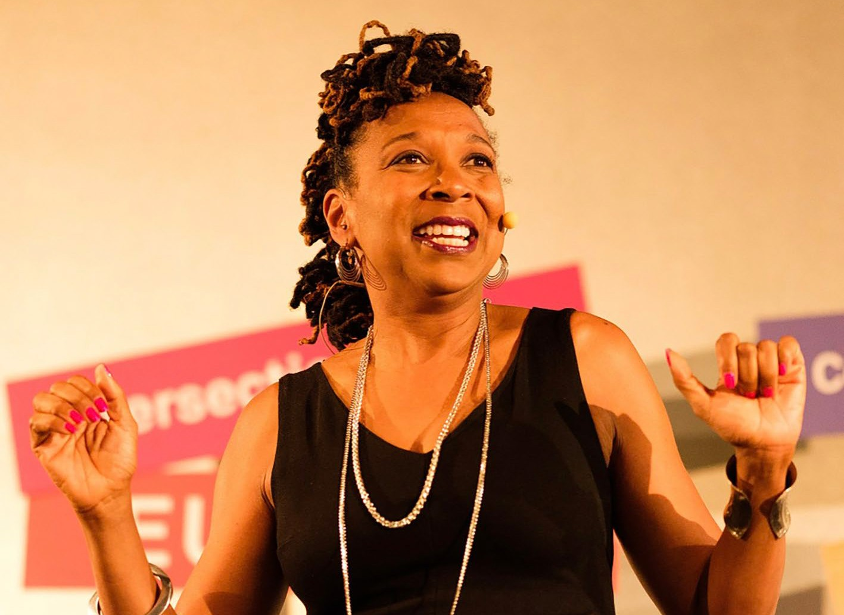
Intersectionality
“a lens, a prism, for seeing the way in which various forms of inequality often operate together and exacerbate each other. We tend to talk about race inequality as separate from inequality based on gender, class, sexuality or immigrant status.
What’s often missing is how some people are subject to all of these, and the experience is not
just the sum of its parts.”
Kimberlé Crenshaw
Notes:
Let participants read the quote on the slide.
Ask participants if they know about intersectionality or Kimberlé Crenshaw.
The concept of intersectionality was coined by Kimberlé Crenshaw whom you can see on the slide.
Kimberlé Crenshaw is a professor of law at UCLA and Columbia Law School, and known for her work on civil rights, critical race theory, Black feminist legal theory, and race, racism and the law.
Intersectionality describes the double bind of simultaneous racial and gender prejudice.

Slide 20
Intersectionality
Gender & gender identity
Class
Disability
Sexual orientation
Health
Economic status
Age
Race Nationality Ethnicity
Tribal affiliation
Job status
Religion / Faith
Notes:
Intersectionality is a very relevant concept when it comes to PSEA. It reminds us that there is no homogenous survivor box.

Slide 21
IASC Core Principles
Notes:
The Six Core Principles originated from the U.N. Secretary General’s (SG’s) Bulletin. The IASC (the coordination body between U.N. and INGOs) has adopted the Six Core Principles, or standards, making them applicable to all organizations and provides updates and clarifications to them. These standards have been adopted by NGOs and U.N. agencies to protect vulnerable populations from sexual exploitation and abuse. They define the prohibited behavior on the part of staff, and outline the duties of managers. The video you saw earlier, No Excuse for Abuse, is based on these standards. Many I(NGO)s have developed their own Codes of Conduct based on these standards.

Slide 22
IASC Core Principles
_{1.} Sexual exploitation and abuse by humanitarian workers constitute acts of gross misconduct and
are therefore grounds for termination of employment.
2.
_{3.} Exchange of money, employment, goods, or services for sex, including sexual favors or other forms of humiliating, degrading or exploitative behavior is prohibited. This includes exchange of
assistance that is due to beneficiaries.
Sexual activity with children (persons under the age of 18) is prohibited regardless of the age of majority or age of consent locally. Mistaken belief regarding the age of a child is not a defense.
Notes:
Adapt this slide: depending on your group:
If participants are from different organizations, or from the same organization but don’t have a Code of Conduct, introduce the IASC principles
If participants are from the same organization, introduce that organization’s Code of Conduct.

Slide 23
IASC Core Principles
_{4.} Any sexual relationship between those providing humanitarian assistance and protection and
a person benefiting from such humanitarian assistance and protection that involves improper
use of rank or position is prohibited. Such relationships undermine the credibility and integrity of humanitarian aid work.
5.
6.
Where a humanitarian worker develops concerns or suspicions regarding sexual abuse or exploitation by a fellow worker, whether in the same agency or not, he or she must report such concerns via established agency reporting mechanisms.
Humanitarian workers are obliged to create and maintain an environment which prevents sexual exploitation and abuse and promotes the implementation of their code of conduct. Managers at all levels have particular responsibilities to support and develop systems which maintain this environment.
Notes:
Adapt this slide: depending on your group:
If participants are from different organizations, or from the same organization but don’t have a Code of Conduct, introduce the IASC principles
If participants are from the same organization, introduce that organization’s Code of Conduct.

Slide 24
IASC Core Principles
1. 2.
3.
SEA constitute acts of gross misconduct and are grounds
for termination of employment.
NO SECOND CHANCES
Sexual activity with children (<18 year of age) is prohibited.
Exchange of money, employment, goods for services for sex is prohibited.
NO SEX WITH CHILDREN
DON’T HIRE/BRIBE ANYONE FOR SEX
4.
Any sexual relationship with beneficiaries that involves improper use of position is prohibited.
NO SEX WITH BENEFICIARIES
5.
Humanitarian workers are obliged to report any concerns regarding SEA by fellow workers.
ALWAYS REPORT SEA
6.
Humanitarian workers are obligated to create and maintain an environment which prevents SEA.
DISCOURAGE SEA AROUND YOU
Adapted from the IASC6 Core Principles relating to SEA, September 2019. Source of the graphic: WFP

Slide 25
Vocabulary note:
survivor and victim
What is the difference?
Notes:
Organizations use different terms to talk about those targeted by sexual exploitation and abuse. Some may use victim, others survivor, some both.
Ask participants if they know the difference between these two terms.

Slide 26
Vocabulary note Survivor and victim
Victim
Survivor
victims of sexual violence are those individuals who directly experienced the violence
as well as those who were indirectly affected (e.g. children born of sexual abuse).
Notes:
Victim is a legal term.

Slide 27
Vocabulary note Survivor and victim
Victim
Survivor
“survivor” is more commonly used in connection with the healing process of an individual who experienced sexual violence as it implies agency and resiliency.
Notes:
The term survivor emphasizes empowerment.

Slide 28
The impact of SEA
Survivors
Perpetrators
Impact of SEA
Organization
Conmmunity
Notes:
We are going to discuss the far-reaching impact that sexual exploitation and abuse can have on survivors, perpetrators, the organization and the community. You will break into groups to discuss the impact sexual exploitation and abuse can have on each of these. Make sure to appoint a notetaker and a rapporteur.
Participants discuss in small groups for 10 minutes.
Debrief with the group and document the results on a flipchart.
Impact on Victim/Survivor:
The biggest impact is on the victim. Victims can experience considerable harm. The impact can include (but is not limited to):
Distress
Fear
Embarrassment
Concern about reputation
Fear of reprisal from colleagues
Seen as a trouble maker
Stigma
Concern about confidentiality
Family impact
People not believing them
Harm to health, psychosocial concerns
Emotional stress and strain
Loss of trust
Fear of losing job
Threats
Colleagues suspicious of them
Ensure that child victims are also mentioned for the harm they can experience such as (but not limited to):
Negative effects on development and health
Psychological harm
Fear of further sexual assaults, violence and possible assaults by others, friends and neighbors
Emotional repercussions
Negative reactions of family
Family difficulty in caring for sexually abused child
Lack of access to support
Risk of being forced into an early marriage
Removal or interruption of educational opportunities
Impact on the Perpetrator:
Disciplinary action*
Inability to support family
Emotional stress
Violence and reprisals from staff and community
Deportation
Criminal proceedings and incarceration
Loss of friends
Stigma within community
Effect on status in community
Impact on Organization:
Loss of community trust
Publicity
Reputation
Withdrawal of funding
Host nation may request they stop operations
Management of project is delayed or stopped
Divisions in staff team and other suspicions
Lack of cooperation by staff and other agencies
Turnover of staff
Difficulty in recruiting quality staff because of reputation
Impact on Community:
Fear that international community will think badly of the community
Fear of possible loss of funding, support, etc.
Blaming various community members for allowing this to happen
Suspicion of NGOs

Slide 29
Terms and definitions
Sexual exploitation
Sexual abuse
Sexual harassment
Notes:
This section introduces the three forms of sexual misconduct. All three are based on power differentials, and often unequal gender roles that we discussed earlier. However, it is also important to mention that people of all genders can be perpetrators and survivors.
Let’s first look at UN documents official definitions.

Slide 30
Terms and definitions
Sexual harassment
Sexual exploitation
Sexual abuse
Any actual or attempted abuse of position of vulnerability, differential power, or trust, for sexual purposes, including but not limited to, profiting monetarily, socially, or politically from the sexual exploitation of persons of concern.
Notes:
This section introduces the three forms of sexual misconduct. All three are based on power differentials, and often unequal gender roles that we discussed earlier. However, it is also important to mention that people of all genders can be perpetrators and survivors.
Let’s first look at UN documents official definitions.

Slide 31
Terms and definitions
Sexual harassment
Sexual exploitation
Sexual abuse
The actual or threatened physical intrusion of a sexual nature, whether by force, or under unequal or coercive conditions.

Slide 32
Terms and definitions
Sexual harassment
Sexual exploitation
Sexual abuse
Unwelcome sexual advance, request for sexual favor, verbal or physical conduct or gesture of a sexual nature that might reasonably be expected to be perceived to cause offense or humiliation to another.
Sexual harassment is particularly serious when it interferes, is made a condition of employment or creates an intimidating, hostile or offensive environment.

Slide 33
Terms and definitions
Sexual exploitation
Sexual harassment
Sexual abuse
How would you describe them in your own language?
How would you describe them in plain language to others such as family members, neighbours and others in our lives.
Notes:
We are going to break into groups. Each group is to define one of these terms (sexual exploitation,
abuse, and harassment) using your own language to make the terms more understandable. Use
examples that you could present to family and friends when discussing what you have learned today.
Please describe these terms in a way that could help people better understand the term. For example,
please list what behaviors might be included within your definition, and the local terms for those
behaviors. Note your responses and nominate one person from your group to present to the larger
group.
2. Trainer distributes a handout to each group
You can use the question on your handout to guide your reflexion.

Slide 34
Defining sexual misconduct
Sexual exploitation |  | Sexual abuse | Sexual harassment
Who? | Us + program participant | Us + program participant | Us + Us
What? | Abuse of vulnerability, differential power, or trust Victim/survivor’s sexual activity generates benefits | Physical intrusion of a sexual nature Use of force or coercion | Unwelcome advance or conduct of a sexual nature Creates an intimidating environment or becomes a condition of employment
Examples? | Offering money, gifts, or a job in exchange for sex Withholding due services or blackmailing for sex Hiring sex workers Threats of sexual exploitaion | Unwanted kissing, touching, grabbing or rubbing Threats of an unwanted sexual act Raping or attempted rape Any sexual activity with a child | Touching, kissing or speaking inappropriately to a colleague at work Attempted or actual sexual assault Raping or attempted rape
Source: Saying No to sexual misconduct, IASC
Notes:
Here is a diagram from IASC to help visualize the differences between each term.
Note: the diagram originally uses the term “prostitute”. Here it was changed to sex workers.

Slide 35
Identifying
SEA
Notes:
We may know the theory and legal definitions of SEA, but that does not mean we know how to identify it. That is what we will work on in this next section.

Slide 36
Case studies
In groups:
name a notetaker and a rapporteur
discuss the case study using the handout as a guide
Notes:
Refer to the handout for details instructions.

Slide 37
Conclusion

Slide 38
?

Slide 39
Thank you and see you tomorrow!

