Slide 1
Training on prevention of sexual exploitation and abuse

Slide 2
Training programme:
 | Day 1 | Day 2
Morning | Hello and welcome What is SEA? | Reporting SEA Conclusion
Afternoon | The Six Core Principles and the Code of Conduct Identifying SEA
Notes:
Trainers present:
the programme
time and session duration
number of breaks

Slide 3
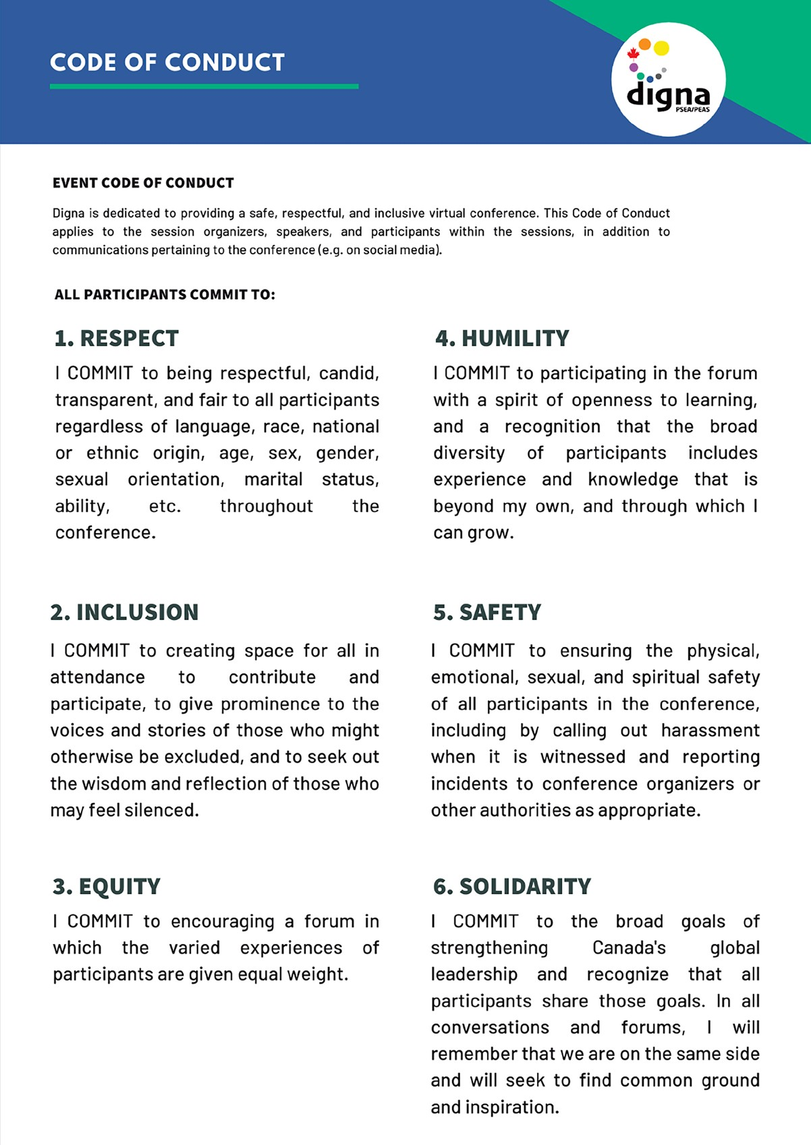
Code of Conduct:
Notes:
Remind participants that you will follow the Code of Conduct from Digna.

Slide 4
Trigger warning:
Psychosocial support available
Notes:
Trainers give a trigger warning to participants:
Sexual abuse and exploitation is a sensitive topic. It may trigger difficult emotions or remind you of things you have experienced or seen. Do not hesitate to take a break if you need or come and find us.
Adapt this slide
If you are offering psychosocial support to participants, introduce the system and how they can use it.
Distribute a list of emergency contact participants can reach out to for support.

Slide 5
Safer space guidelines:
Care & self-care
Active listening
Respect
Integrity
Confidentiality
No disclosing
Notes:
Trainers introduce the safer spaces guidelines:
Principles of engagement are necessary in any training in order to create a learning environment that is as comfortable as possible for everyone. Although no space can be entirely safe, there are things we can all do to make it safer:
care and self-care
active listening
respect
integrity
confidentiality
no disclosing
Trainers ask participants if they would like to add anything to the list.

Slide 6
Check-in:
How are you doing today?
What is your main takeaway from yesterday?
Do you still have questions?
Notes:
Divide participants in pair and give them 5 minutes to chat.

Slide 7
?
Notes:
Ask participants: are there things that need to be clarified before we continue?

Slide 8
Reporting SEA
Notes:
Yesterday, we talked about:
the important of treating program participants with respect and not abuse of one’s power and authority
how to recognize sexual exploitation and abuse
principles that we must abide by as set out in the organization’s Code of Conduct and/or the IASC Six Principles
the obligation of humanitarian and international cooperation workers to report SEA
But how do we report it? What happens to our reports? These are important questions you may have, and this session will help you understand the reporting system in the organization.
This session only focuses on our duty to report, and to understand how those reports are handled by the organization. We are not discussing any reporting mechanisms that may be available in the community: only about how YOU can report and what happens with your report.

Slide 9
Principles of a reporting system:
Collective brainstorming
Notes:
Before we dive deeper into the details, let’s see if we can first identify some of the key principles that are important when creating and operating an internal staff reporting system.
Use the handout for detailed instructions for this exercise.

Slide 10
Principles of a reporting system:
Survivor- centred
Confidentiality
Thorough
Integrity
Safety, security and well-being
Accountability / particpation
Independence
Transparency
Process is well known / accessible
Timelines
Impartiality
Objectivity

Slide 11
Elements of a reporting system:
Who?
When?
Why?
What?
Where?
How?
Notes:
Now that we have identified some key principles for a good report handling system, let’s explore in more detail what the reporting process looks like in this organization and see how those principles show up.
Use the handout for detailed instructions for this exercise.

Slide 12
Barriers to reporting and solutions to overcome barriers
Impacts
Why don’t people report it?
Causes
Notes:
We will now be exploring some of the reasons why people do not report when they have experienced SEA by creating a “problem tree.”
Each group is going to design their own tree—the trunk of the tree is the “problem”—people not reporting SEA violations. At the “roots” are the causes: Why do people not report? The “leaves” are the impacts: What happens when people don’t report?
Use the handout for detailed instructions for this exercise.

Slide 13
Why don’t women report?

Slide 14
Why don’t men report?

Slide 15
Why don’t children report?

Slide 16
Why don’t persons with disabilities report?

Slide 17
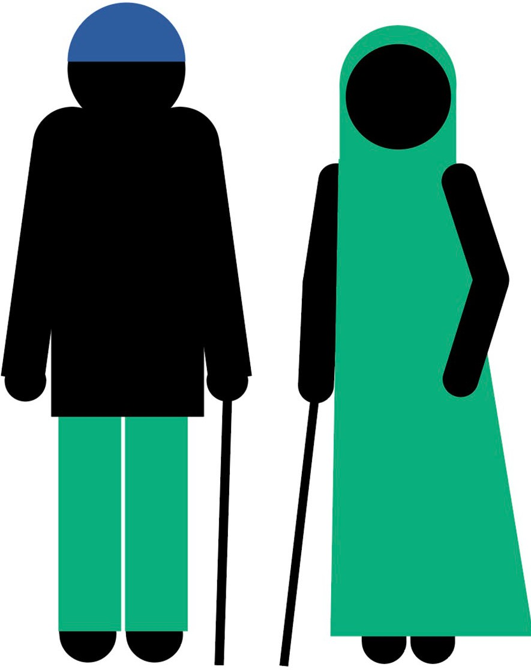
Why don’t older people report?

Slide 18
Solutions for our problem tree
Activity:
Brainstorm ways we can overcome reporting barriers.

Slide 19
Closing

Slide 20
Check-out
One thing that is sticking with you
One question that remains with you.
Notes:
We will give you 10 minutes to process the things you have discussed and learned during the training in pairs.

Slide 21
?
Notes:
Do you have questions you would like to address with the whole group?

Slide 22
Journalling
What will be your first 3 steps after this training?
Notes:
Let us take 5 minutes to list the first three things you will do after this training, to implement what you have learned.

Slide 23
Thank you!
Stay connected with us
www.digna.ca
Digna.info@cooperation.ca
@Digna_Can
/dignacan
www.linkedin.com/showcase/digna_can

